Slide 1
https://enederita.wixsite.com/preciouspetals

Slide 2
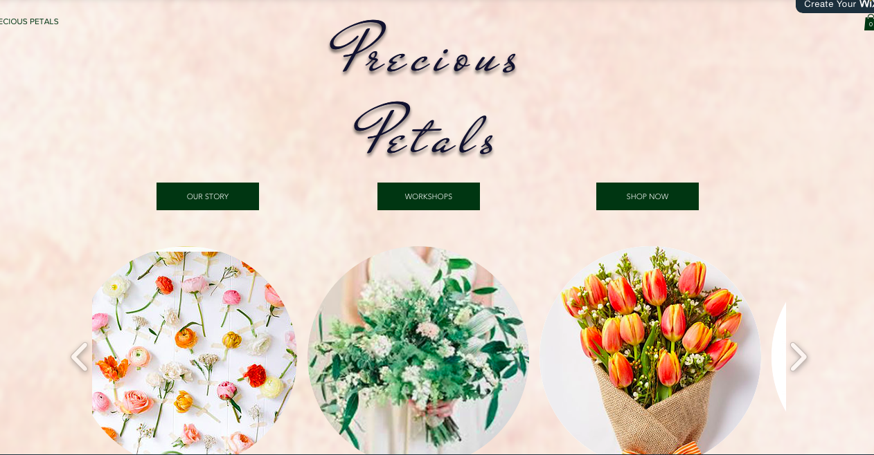
Floral Arrangement Shop

Slide 3

Product Differentiation Business Strategy
Offering a full mobile app service to order flowers
- Special “day of” ordering
Developing a customer database that identifies contact information and preferences
- colors, vases, frequency, allergies, children/spouse, birthday, anniversary
Flowers are categorized in different categories so easy to locate/order
- anniversaries, holidays, weddings, birthdays, just because
Flower arrangement workshops
- 2 hour (individual and group classes) offered on the weekends
Proactive customer service policies
-Contact Frequent Flower Program Member within 3 days of a delivery for feedback

Slide 4

Web Strategy
Goal:
Create a useful website that will provide information about:
New product lines
Arrangements
Workshop plans
The website will also communicate company news to create and maintain positive public relations with the online community through clickable links.
A two-way link between our website and our products suppliers is maintained. We also maintain a two-way link between event organizers in order to attract more customers through our lawn and landscaping services.

Slide 5


How They Support Each Other:
Through Social Media
Social media websites: Facebook, Instagram
Mobile Device Apps: Flower Ordering Service, Member Rewards Points
Provide weekly updates on our latest seasonal arrangement deals
Offer monthly gift card giveaways to customers who share the most Precious Petals’ posts

Slide 6
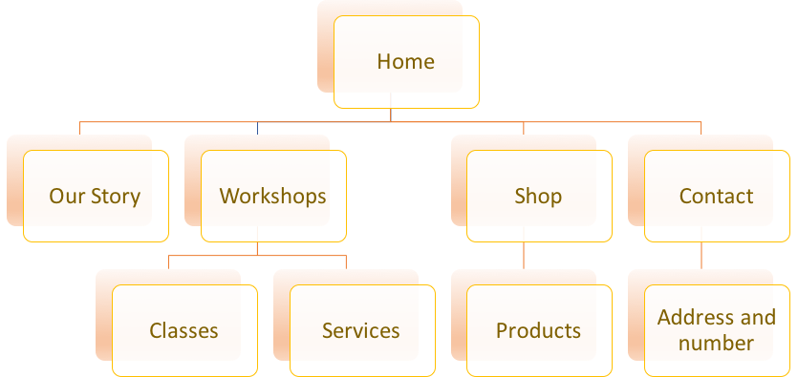
Website Hierarchy

Slide 7

Information Planned to Capture
On our website, we will monitor our customer's actions, therefore, it could help us improve our services.
Best selling products.
Methods of payment used.
Times of high demand (services, classes).

Slide 8
Technical Details
Personal survey at the end of shopping
Register to our newsletter for special offers
Payment processed through paypal
Mobile version of a website when order online
4
No need of registration for shopping
1
Separate bar menu - “shop now”
5
2
6
3

Slide 9

Payment
Paypal/credit & debit transactions & cash with a merchant & banking account.
All of the proceeds are placed into a bank account (both cash & credit).
Payroll & bills are deducted
Merchant account deposits the funds from credit card sales into banking account.
Precious Petals does not have a third party processor, but our company has a merchant account through Fattmerchant because:
  startup costs are negligible and our stream of clients is large enough to quickly outweigh the costs.
  We will never see any startup costs and the 0% markups will counteract the monthly membership ($20.00 per month).
  We will have more security.

Slide 10
Data Reports
Key External Drivers
Current Performance
Industry Outlook
Industry Life Cycle
Industry Analysis, Statistics, Trends, and Forecasts
Financial Information and Financial Ratios
Compensation and Salary Surveys
Business Valuation Resources
Industry Data for the Online Flower Shops Analysis includes:
Industry Revenue
Industry Gross Product
Establishments
Businesses
Employment
Wages
% Services conducted online
**ALL REPORTS** sent to CEO, management personnel, Florists' Review Enterprises Inc., & IBIS World

Slide 11
Thank You!
Questions?

